Slide 1
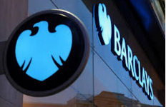
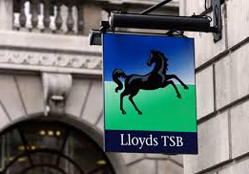
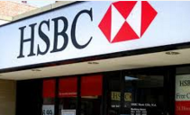
Q#1 : When button maker John Taylor and iron producer and dealer Sampson set up a private banking business in Dale End, Birmingham. The first branch office opened in Oldbury, some six miles (10 km) west of Birmingham, in 1864. The symbol adopted by the founder was the beehive, representing industry and hard work.

Slide 2



Q2 : Which of the worlds largest online travel agencies has announced that they will be accepting bitcoins as a payment method.

Slide 3
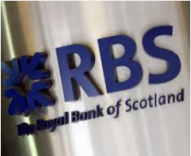
Q#3 : In May 1958, the Bank was the first UK bank to appoint a female bank manager. Hilda Harding managed the Bank’s Hanover Square branch in London

Slide 4
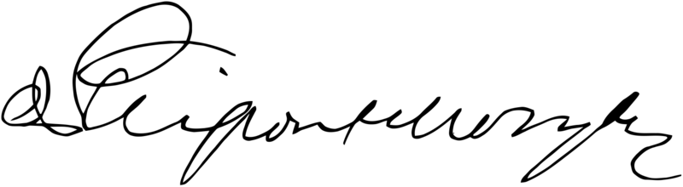
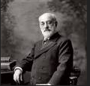
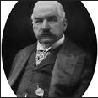
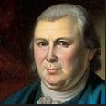
Q#4 : This is it the Signature of United States financier , identify him.

Slide 5
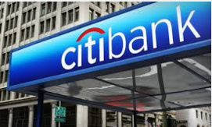
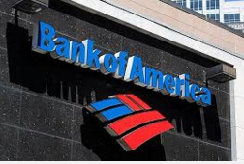
Q#5 :The company organically entered the leasing and credit card sectors, and its introduction of US dollar denominated certificates of deposit in London marked the first new negotiable instrument in the market since 1888. Later to become part of MasterCard, the bank introduced credit card – popularly known as the "Everything Card" in 1967.

Slide 6
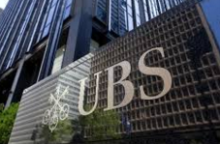
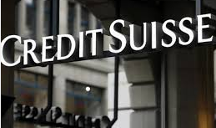
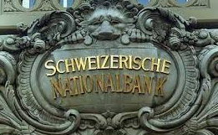
Q#6 :Founded by Alfred Escher in 1856 under the name Schweizerische Kreditanstalt in order to fund the development of Switzerland's rail system. It issued loans that helped create Switzerland's electrical grid and the European rail system. It also helped develop the country's currency system and funded entrepreneurship.

Slide 7
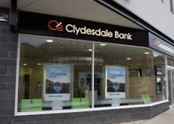
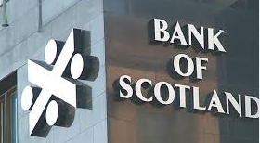
Q#7 : Formed in Glasgow in 1838, it is the smallest of the three Scottish banks. Independent until it was purchased by the Midland Bank in 1920, it was sold to its present owners, the National Australia Bank (NAB) in 1987.

Slide 8



Q#8 : What is a phrase long used on trading floors to describe a short-lived recovery of share prices in a falling stock market.

Slide 9
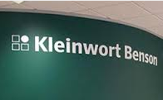
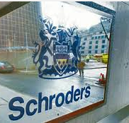
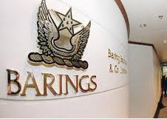
Q#9 : It became one of the first merchant banks to establish itself in the Channel Islands, having set up offices in Jersey in 1962 and Guernsey in 1963.

Slide 10
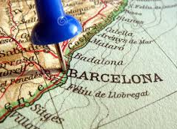
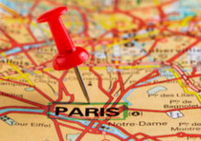
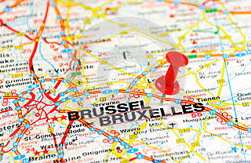
Q#10: Which European city is planning on launching its own digital currency?

Slide 11
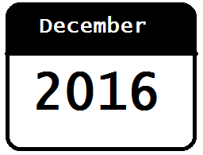
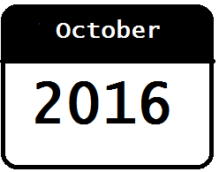
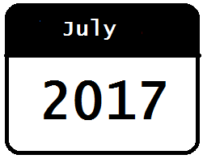
Q#11: At present, SEPA is required for euro payments in the euro area. Non-euro countries, Denmark and the UK are required to join SEPA by what date?

Slide 12
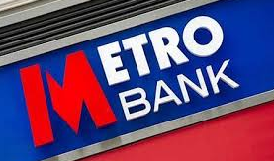
Q#12: Which bank has the following slogan ‘Love your bank at last’?

